Slide 1

Enhancing Pairs Trading:
A Comparative Study of Classical vs LSTM-Based Strategies
PROJECT BY-
ARYA CHUDNAIK (A040)
SURAJ KUSHWAH (A041)
VAISHNAVI ANDHARE (A042)
MAYUR PATIL (A043)
KOUSTUBH CHAUDHARI (A044)
MENTORED BY-
DR. LEENA KULKARNI

Slide 2

INTRODUCTION
Quantitative analysis plays a key role in algorithmic trading strategies.
Pairs trading is a standout technique based on the concept of cointegration.
It identifies pairs of assets that move together over time, allowing for profitable trades.
We’ll explore how this strategy works
How modern techniques like LSTM (Long Short-Term Memory) models enhance its effectiveness.

Slide 3

1
Data collection
Exploratory Data Analysis
2
Table of
Contents
Basic Pairs Trading Strategy
3
LSTM Enhanced Pairs Trading Strategy
4
Comparison and Conclusion
5

Slide 4

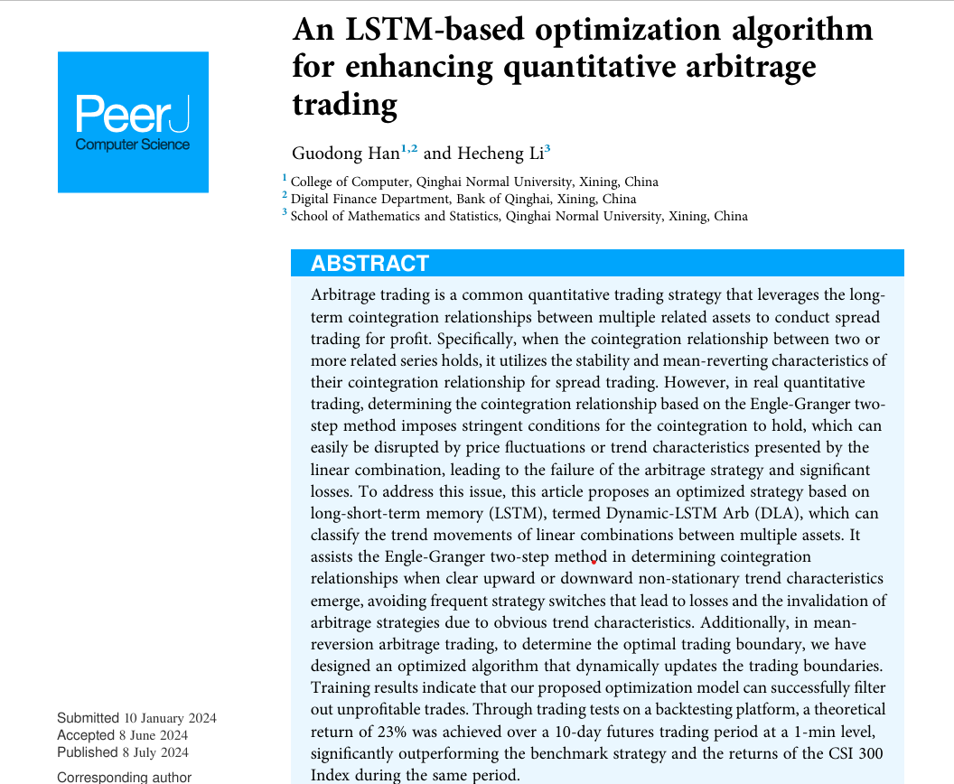

RESEARCH
PAPER
AUTHORS :
Guodong Han
Hecheng Li
JOURNAL NAME :
PeerJ Computer Science

Slide 5
OBJECTIVEs
1
Understand Basic Arbitrage Trading Strategy
2
Enhancing using LSTM based model
3
Optimize Trading Boundaries
4
Reduce losses from market trends
5
Comparison between traditional and LSTM based trading strategy

Slide 6
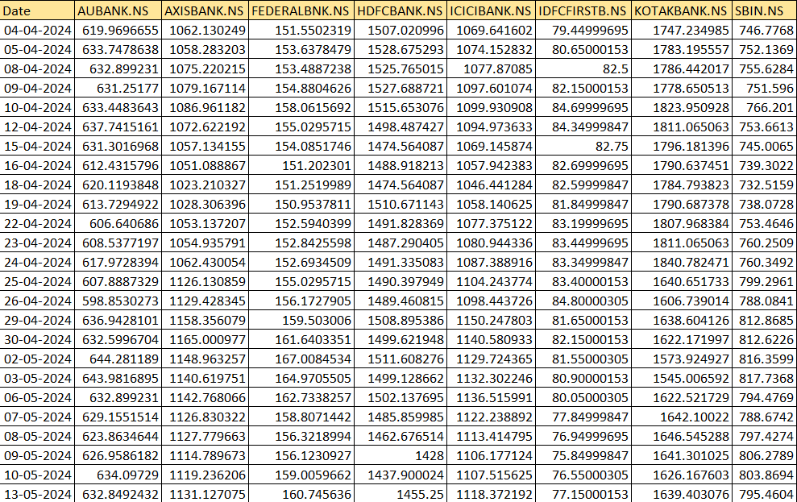
dataset
Period - 1 year (daily data)
Library - Yahoo finance
Sector - Banking

Slide 7
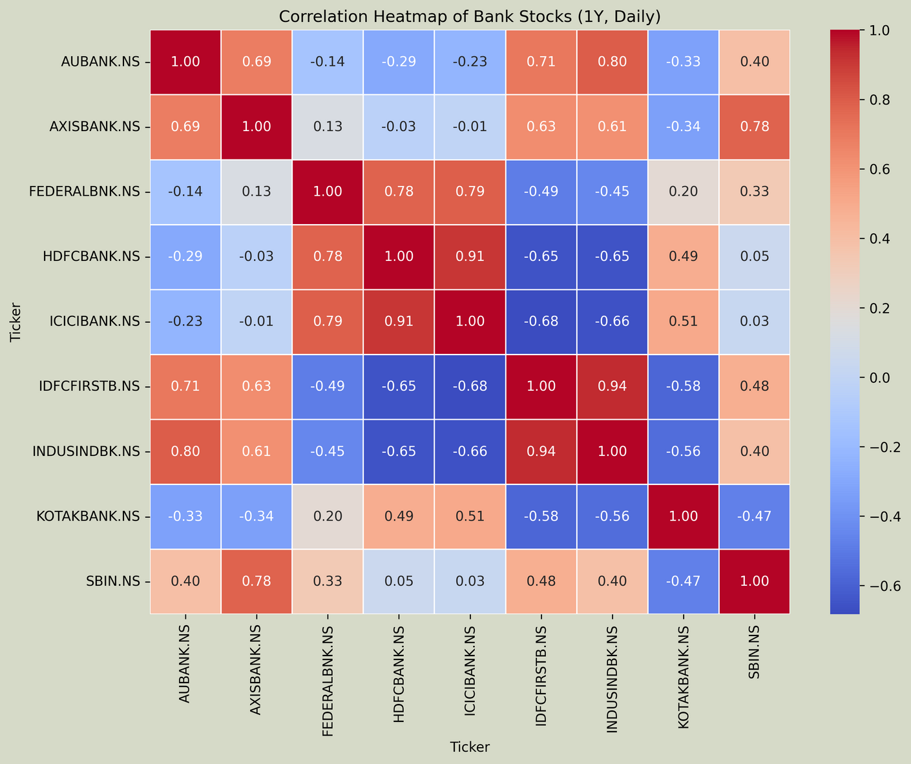
correlation
heatmap
What This Heatmap Shows
Helps identify stock pairs that move together
Candidates for cointegration testing

Slide 8
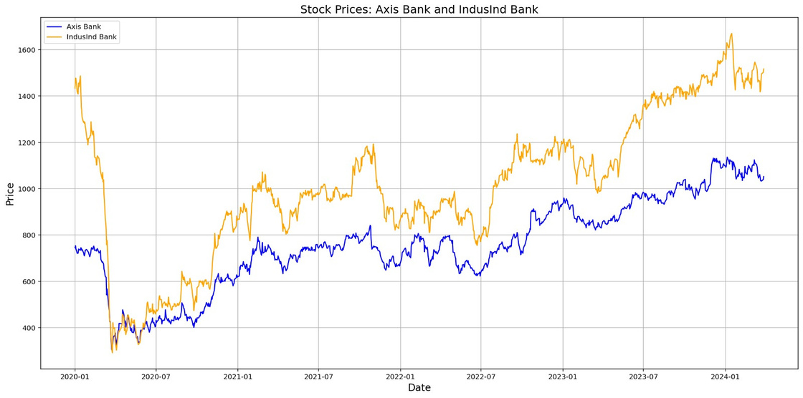
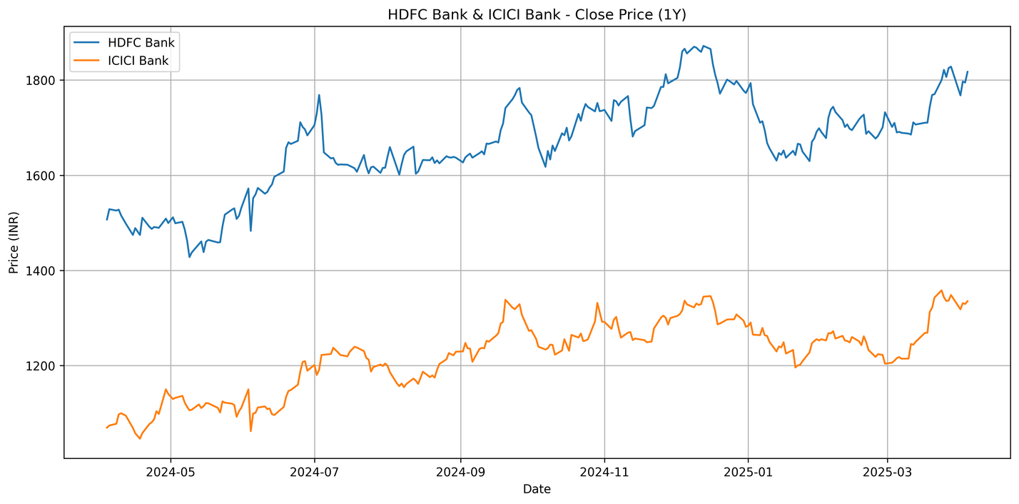
closing price plot
from year (2020-2024)
(Corona Effect)
from year (2024-2025)
(Normal Market Conditions)

Slide 9
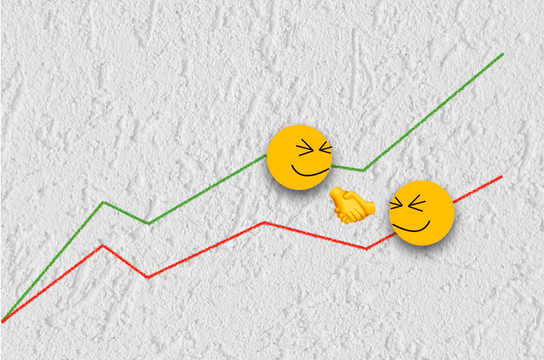
COINTEGRATION
WHAT IS COINTEGRATION?
Cointegration is a concept from time series analysis used to identify a long-term equilibrium relationship between two or more non-stationary time series..
X1 and X2 are cointegrated if
(a) both of them are unit-root nonstationary, and
(b) they have a linear combination that is unit-root stationary.
test used to check cointegration
Engle Granger Two Step Test
Johansen Test

Slide 10
Engle-Granger Two-Step Test
Check prices of both stocks are non-stationary (ADF Test)
Not suitable
NO
YES
Run OLS Regression:
Stock1 = α + β × Stock2 + ε
Not cointegrated
Check residuals for stationarity (ADF Test on ε)
NO
YES
Cointegrated

Slide 11


COINTEGRATION TEST RESULTS
(Engle granger two step test)
Stock 1
Stock 2
p-value
Cointegrated
Sr. No.
1
HDFC BANK.NS
INDUSINBK.NS
ICICI BANK.NS
FEDERAL BNK.NS
FEDERAL BNK.NS
ICICIBANK.NS
IDFCFIRSTB.NS
IDFCFIRSTB.NS
HDFC BANK.NS
ICICIBANK.NS
0.007433
0.083000
0.168409
0.179982
0.201504
2
3
4
5
HDFCBANK And ICICIBANK are the pairs selected for further analysis

Slide 12
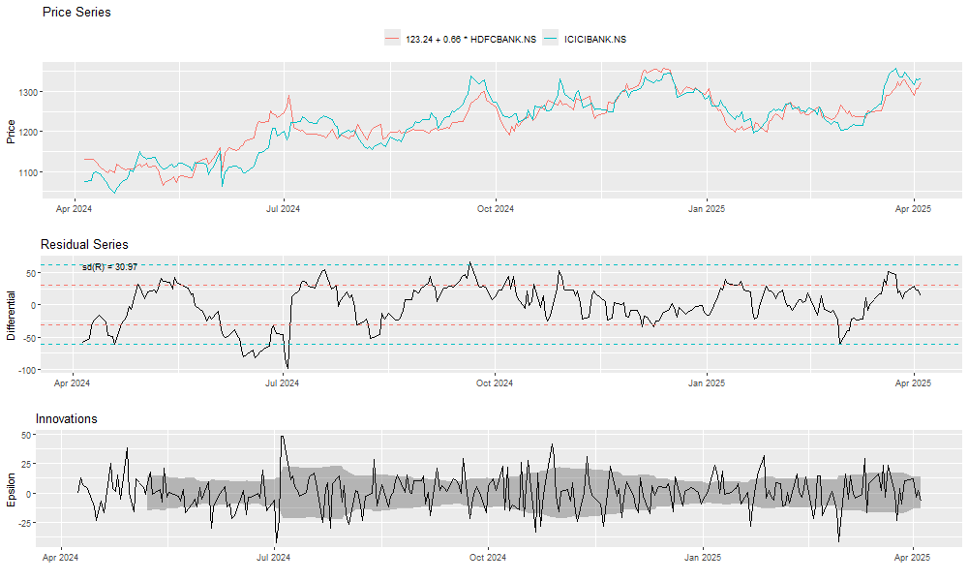
cointegration analysis plots
Plot 1 - Price series plot (leveled)
Plot 2 - Residual plot
Plot 3 - Innovations plot(1st differenced residuals)

Slide 13
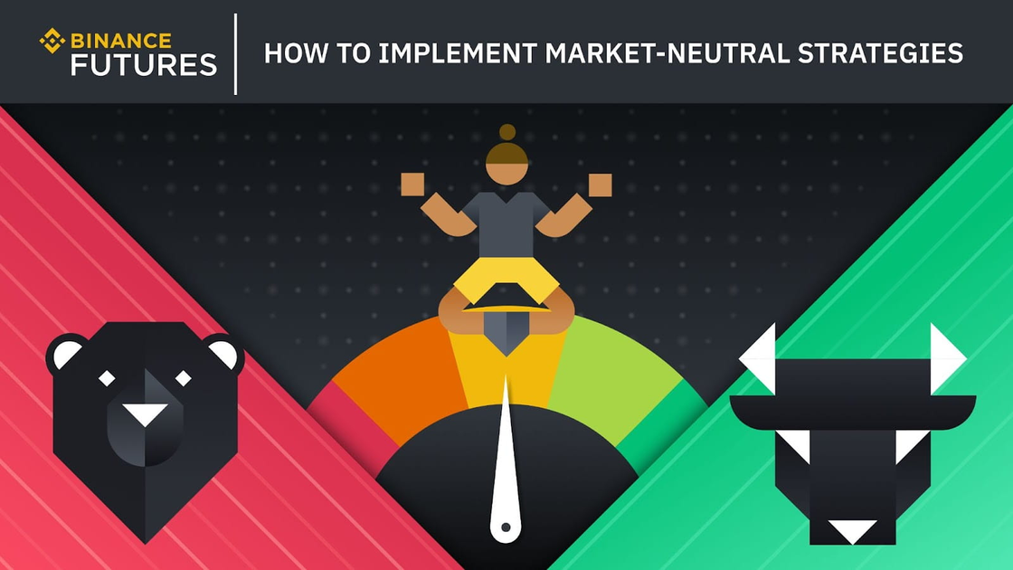
BASIC Pair strategy:
A Market-Neutral Strategy
What: Identify two historically cointegrated stocks and calculate their spread.
When Divergence Happens:
Short the overperforming stock (expect it to drop).
Buy the underperforming stock (expect it to rise).
Profit: When prices converge back to their normal relationship.
Key Idea: The spread between these assets will revert to the mean over time.
BEARISH
NEUTRAL
BULLISH

Slide 14

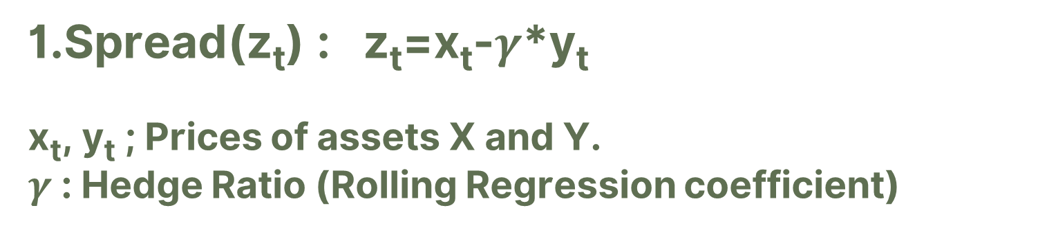
key definitions and Trading boundries
1.Spread(z_{t}) : z_{t}=x_{t}-$γ$*y_{t}
x_{t}, y_{t} ; Prices of assets X and Y.
$γ$: Hedge Ratio (Rolling Regression coefficient)
2.Trading Boundaries
Upper Boundary
Supper =μ + λσ
Lower Boundary
Slower =μ - λσ
μ : Rolling mean of spread ( window = 60 ).
σ : Rolling standard deviation ( window = 60 ).
λ : A tunable multiplier that controls the width of the
boundaries, depends on volatility.
3.Long & Short Positions
Long : Buy low, sell high (profit if price rises).
Short : Sell high, buy low (profit if price falls).

Slide 15
flow chart of basic pairs trading stratergy
Select pairs
Calculate Boundaries
Signal Generation
Trade Execution
NO
Check
Cointegration
YES
Long X | Short Y
Short X | Long Y
YES
If
spread<S_{L}
ELSE
If
spread>S_{U}
YES
Exit on
Mean Reversion

Slide 16
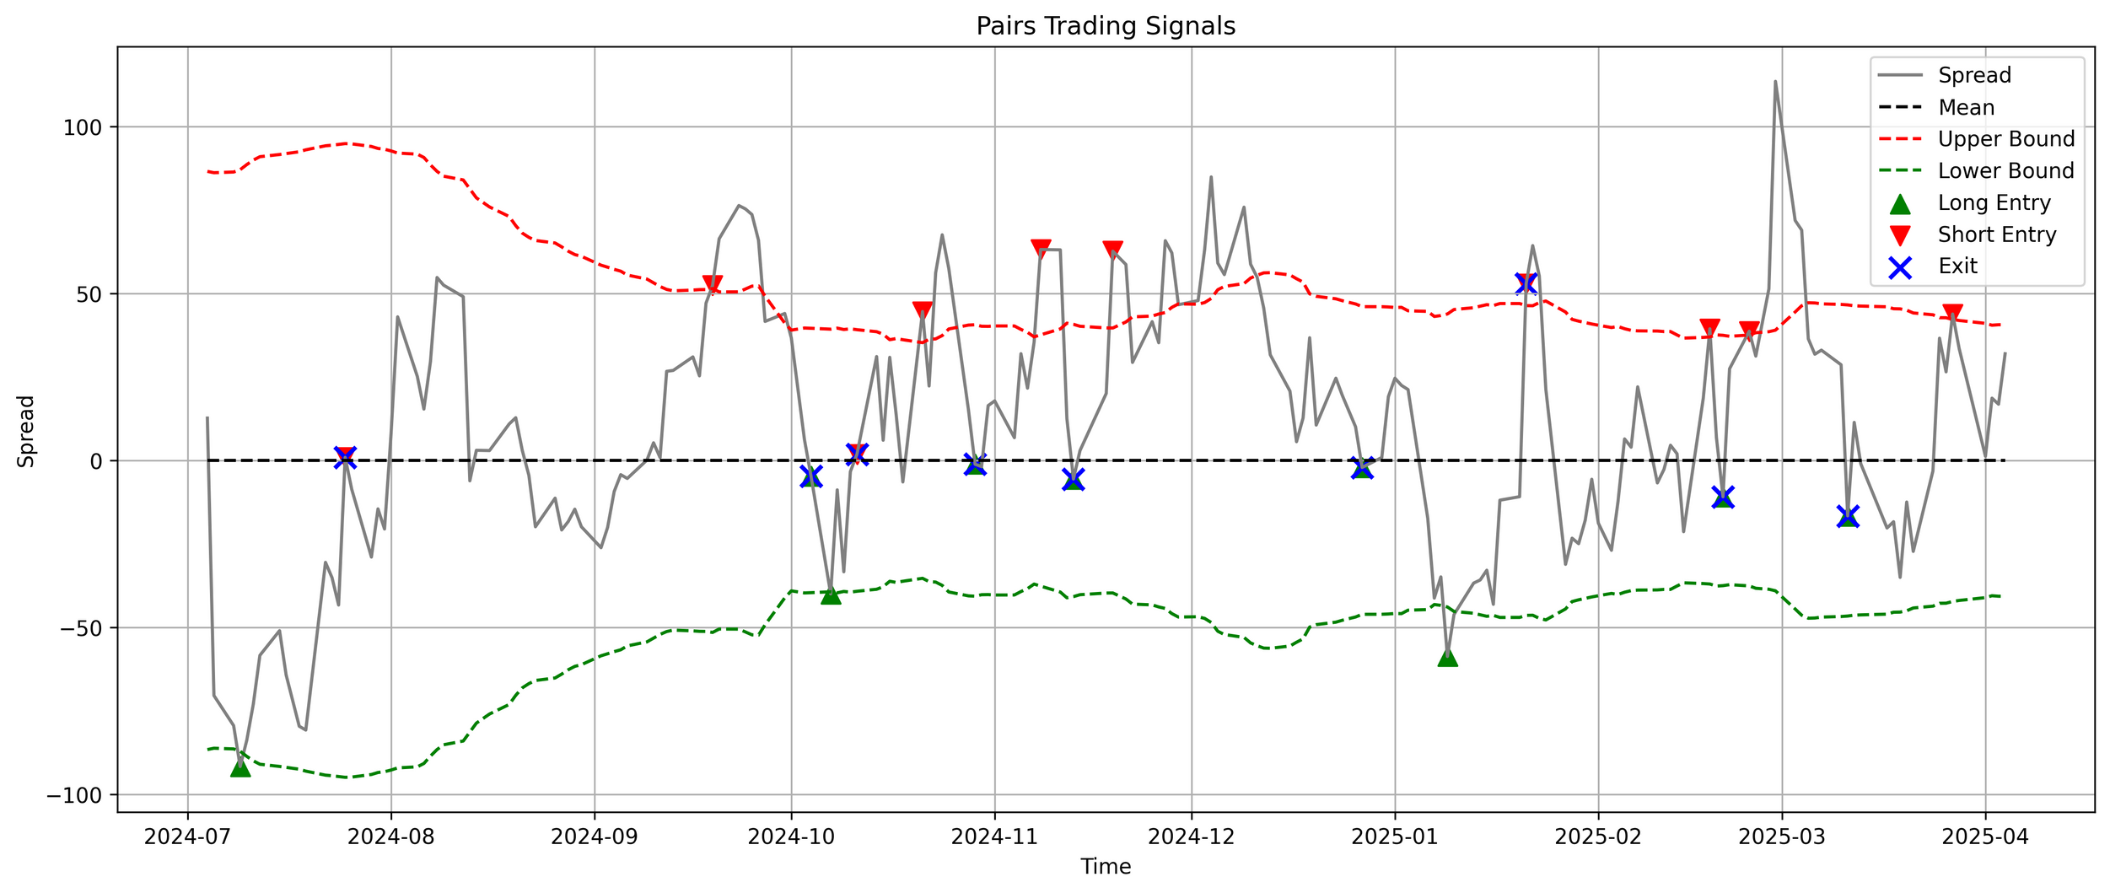
BASIC PAIRS TRADING SIGNALS GRAPH

Slide 17
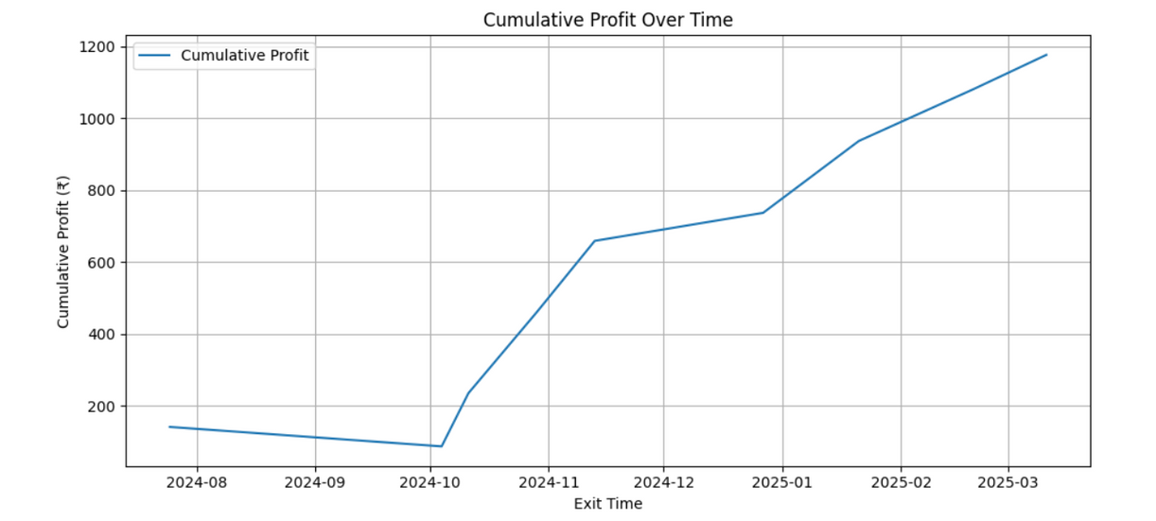

BASIC PAIRS TRADING RESULTS
CUMULATIVE PROFIT CHART
Metric
Value
Initial Capital
₹ 10000
Total Trade
9
Win Rate
88.89%
Sharpe ratio
4.64
Max Drawdown
0.54%
Total Profit
₹ 1176.47
Total Return
11.7 %

Slide 18
BASIC PAIRS TRADING BAcktesting RESULTS FOR DIFFERENT TIME PERIODS
LONGER PERIOD ( 4YEARS, DAILY DATA )
HIGH FREQUENCY ( 8 DAYS, 1MIN DATA )
Metric
Value
Metric
Value
Initial Capital
₹ 10000
Initial Capital
₹ 10000
Total Trade
23
Total Trade
101
Win Rate
86.96%
Win Rate
75.25%
Sharpe ratio
1.83
Sharpe ratio
3.11
Max Drawdown
0.39%
Max Drawdown
0.75%
Total Profit
₹2920
Total Profit
₹430.02
Total Return
29.2%
Total Return
4.30%

Slide 19
PROBLEMS FACED BY BASIC PAIRS TRADING STRATEGY
problems in basic pairs trading
Trend Risk: Spread z_{t​} may trend instead of mean-reverting → losses.
Cointegration Sensitivity: Engle-Granger test may overreact to noise → false exits.
Fixed Thresholds: Static thresholds don't adapt to volatility → missed trades or overtrading.
Trend Detection: LSTM skips trades during strong trends → reduces losses.
Dynamic Thresholds: Adjusts boundaries based on volatility → improves trade balance.
Smart Execution: Hybrid logic adds context → avoids false trade signals.
LSTM BASED SOLUTION

Slide 20

Long short term memory ( lstm )
what is lstm ?
LSTM is a special type of Recurrent Neural Network (RNN) designed to learn from sequential data — like time series, sentences, etc.
While avoiding problems like vanishing gradients (which RNNs often suffer from).
It can remember long-term dependencies and is widely used for tasks like stock price prediction, NLP, volatility forecasting, anomaly detection etc.

Slide 21
LSTM MODEl architecture
data preparation
Input : Data
1.Load both stock data
LSTM Layer
2. Calculate 8 features
Dense Layer
Softmax Layer
3. Label trends
Output
4. Window size = 30
Downward
Upward
Neutral
5. Train LSTM classifier for 100 epoch using cross-entropy loss

Slide 22
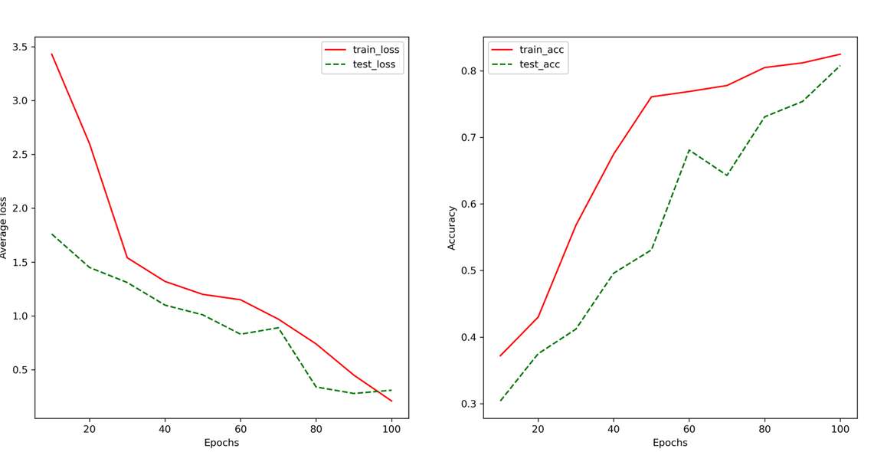
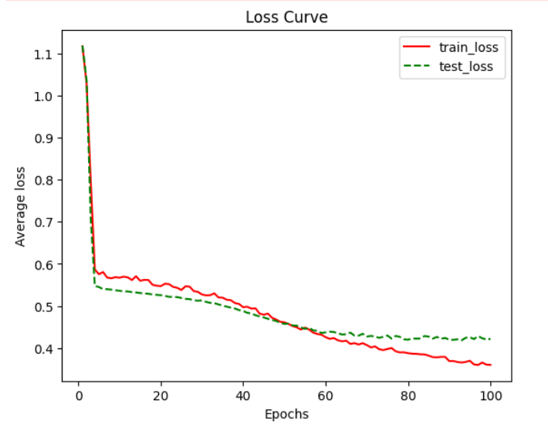
MODEL EVALUATION GRAPHS
Accuracy curve
Both training and testing accuracy increase over time, which is a good sign.
Model reaches ~84% training accuracy and ~81% test accuracy.
The average loss is decreasing consistently across epochs for both training and test sets.
There's no sudden jump or instability in test loss, meaning the model is stable.

Slide 23
flow chart of LSTM ENHANCED STRATEGY
Select pairs
Calculate Boundaries
Signal Generation
Trade Execution
NO
Check
Cointegration
YES
If
spread<SL
And LSTM Pred
Trend =0
If
spread>Su
And LSTM Pred
Trend=0
Long X | Short Y
Short X | Long Y
YES
ELSE
YES
Exit on
Mean Reversion

Slide 24
results & comparison
Metric
Value
(Without LSTM)
Value (LSTM)
Initial Capital
₹ 10000
₹ 10000
LSTM reduced number of trades while still maintaining a high win rate.
Max drawdown was lower with LSTM — indicating better risk control.
Slight drop in total profit and return — due to fewer trades.
LSTM improved risk-adjusted performance, even if raw profit dropped.
While Bank NIFTY Index gives 6% returns in same time period.
Total Trade
9
7
Win Rate
88.89%
85.71%
Sharpe ratio
4.64
5.07
Max Drawdown
0.54%
0.043%
Total Profit
₹ 1176.47
₹966.10
Total Return
11.7 %
9.66 %

Slide 25
Conclusion & Key Takeaways
LSTM-based strategy is better in volatile markets, offering:
1. More consistent returns
2. Lower drawdowns
3. Better risk control by filtering risky
trades
Risk-Return Tradeoff:
1.With LSTM: Fewer trades, lower profits, but more stability
2.Without LSTM: More trades, higher profits, slightly higher risk
Ideal for low-frequency, high-confidence arbitrage systems
Pairs trading is a complex strategy used by hedge funds
Involves risks like cointegration breakdown and market shocks
Requires active monitoring, infrastructure, and discipline
Not recommended for retail traders without proper tools, risk controls and knowledge

Slide 26
limitationS :
Specific market conditions and dataset
Neglect of real-world trading factors
Lack of automation
Limited scope of pair selection
Dataset limitations
FUTURE SCOPE :
Use different ML/trade filtering techniques and compare results
Testing both strategies on live data and comparing results
Mimicking a real trading environment (slippage, brokerage, stop-loss)
Finding pairs for different sectors
Automating the entire process
Integrated future research plan

Slide 27
references
An LSTM-based optimization algorithm for enhancing quantitative arbitrage trading, PeerJ Computer Science, 2024
Designing Efficient Pair-Trading Strategies Using Cointegration for the Indian Stock Market,2022 2nd Asian Conference on Innovation in Technology (ASIANCON) Pune, India. Aug 26-28, 2022.
A cointegration and clustering based approach to pair trading of stocks from selected sector of the Indian Stock Market.

Slide 28


Thank You

